Slide 1

CAPSTONE 2 FINAL REPORT

Slide 2


Predicting popular songs using the structure of SPOTIFY’S popular songs in the past two decades

Slide 3

Problem Identification
This project seeks to help artists, music distributors and record label managers maximize financial benefits from their association with Spotify by building a model that will help predict songs using the structure of popular songs from 2000 -2023

Slide 4

Data Sources
Main data
Kaggle Spotify dataset
(1159796 rows)
Genre
Track Id
liveness
Track name
Popularity
Danceability
Loudness
Acousticness
Instrumentalness
Tempo
Duration_ms
Year
Valence
artist name
Mode
Key
Energy
Speechiness
Time signature

Slide 5
Supplementary dataset
(5 rows)
Annual GDP of the United States from 1929 to 2023
Columns
Years from 1929- 2023)
Rows
1.Gross domestic products
2.By type
3.Private industries
4.By industry
5.Agriculture, forestry, fishing

Slide 6

DATA WRANGLING
Handling of missing values
Dropping irrelevant columns from both datasets
Replacing missing values with ‘0’
Conversion of values
Conversion of values in duration column in main dataset into minutes from milliseconds
Producing final dataset
Merging the two cleaned datasets into one pandas data frame

Slide 7

Resulting features in merged dataset
popularity
loudness
GDP
intrumentalness
Duration
Year
GDP year
Tempo
Acousticness
Liveness
Genre

Slide 8

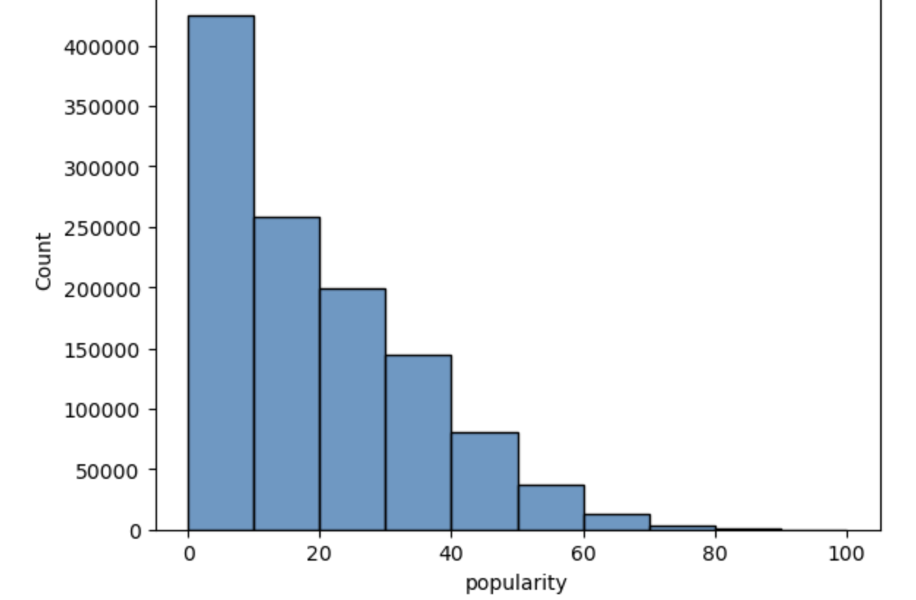
Distribution of Dependent feature
Popularity is the dependent feature
It has a left skewed and a long tail distribution

Slide 9
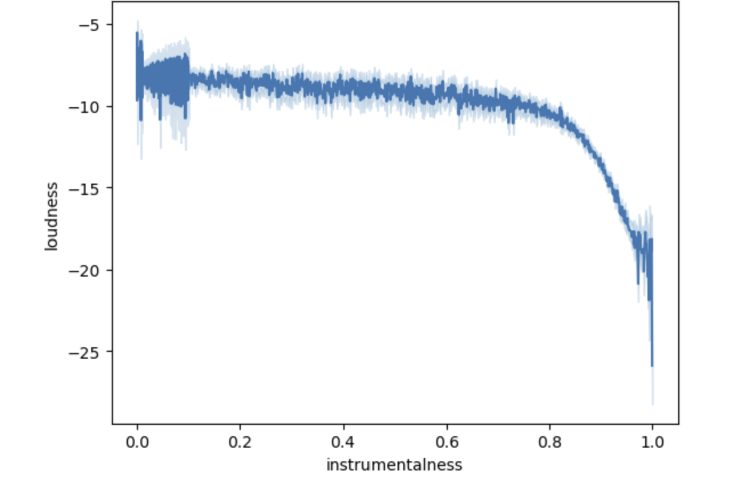
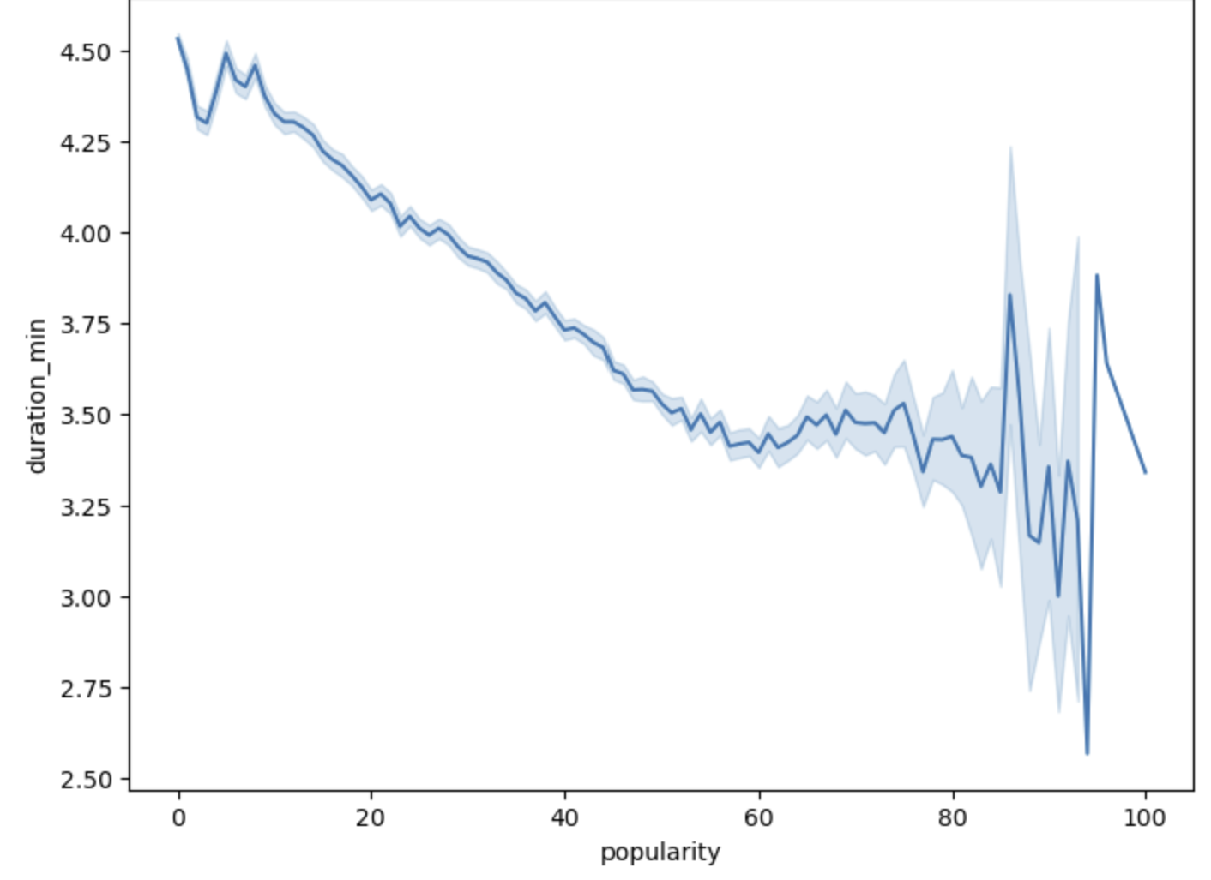
EDA
EDA showed that the song feature, instrumentalness, was not related to loudness and this is evident from the first graph
Songs with longer durations are not popular songs and this is shown in the graph below

Slide 10

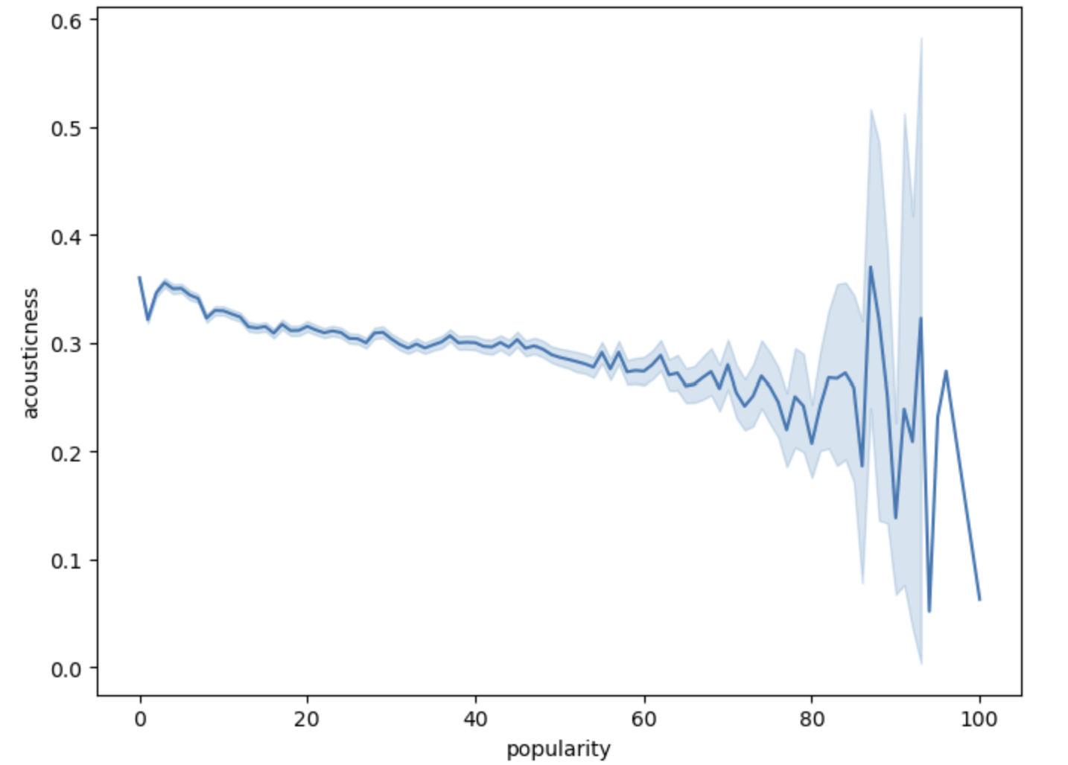
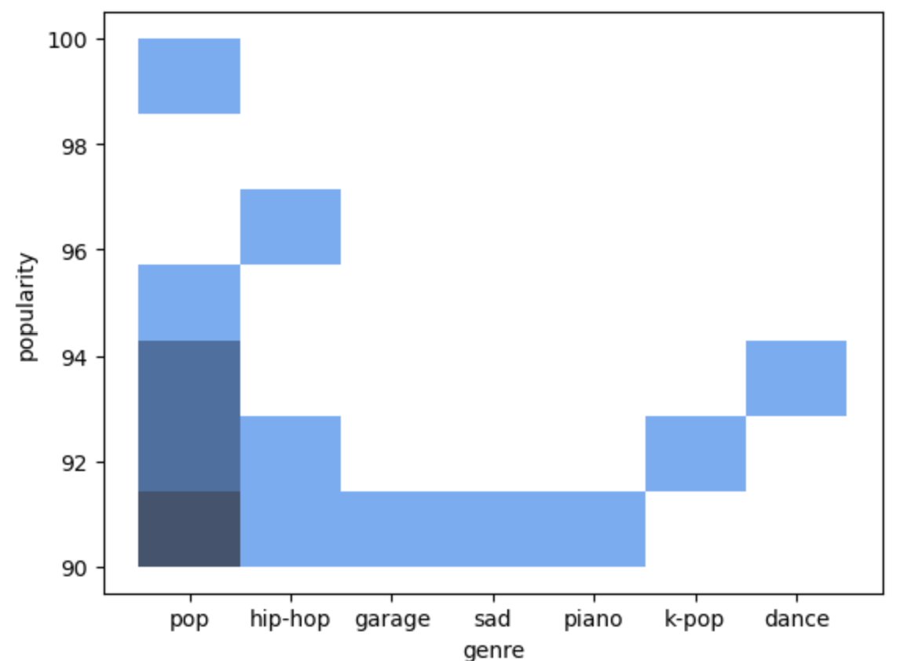
EDA showed that popular songs have low acousticness
The most popular song genre was pop

Slide 11
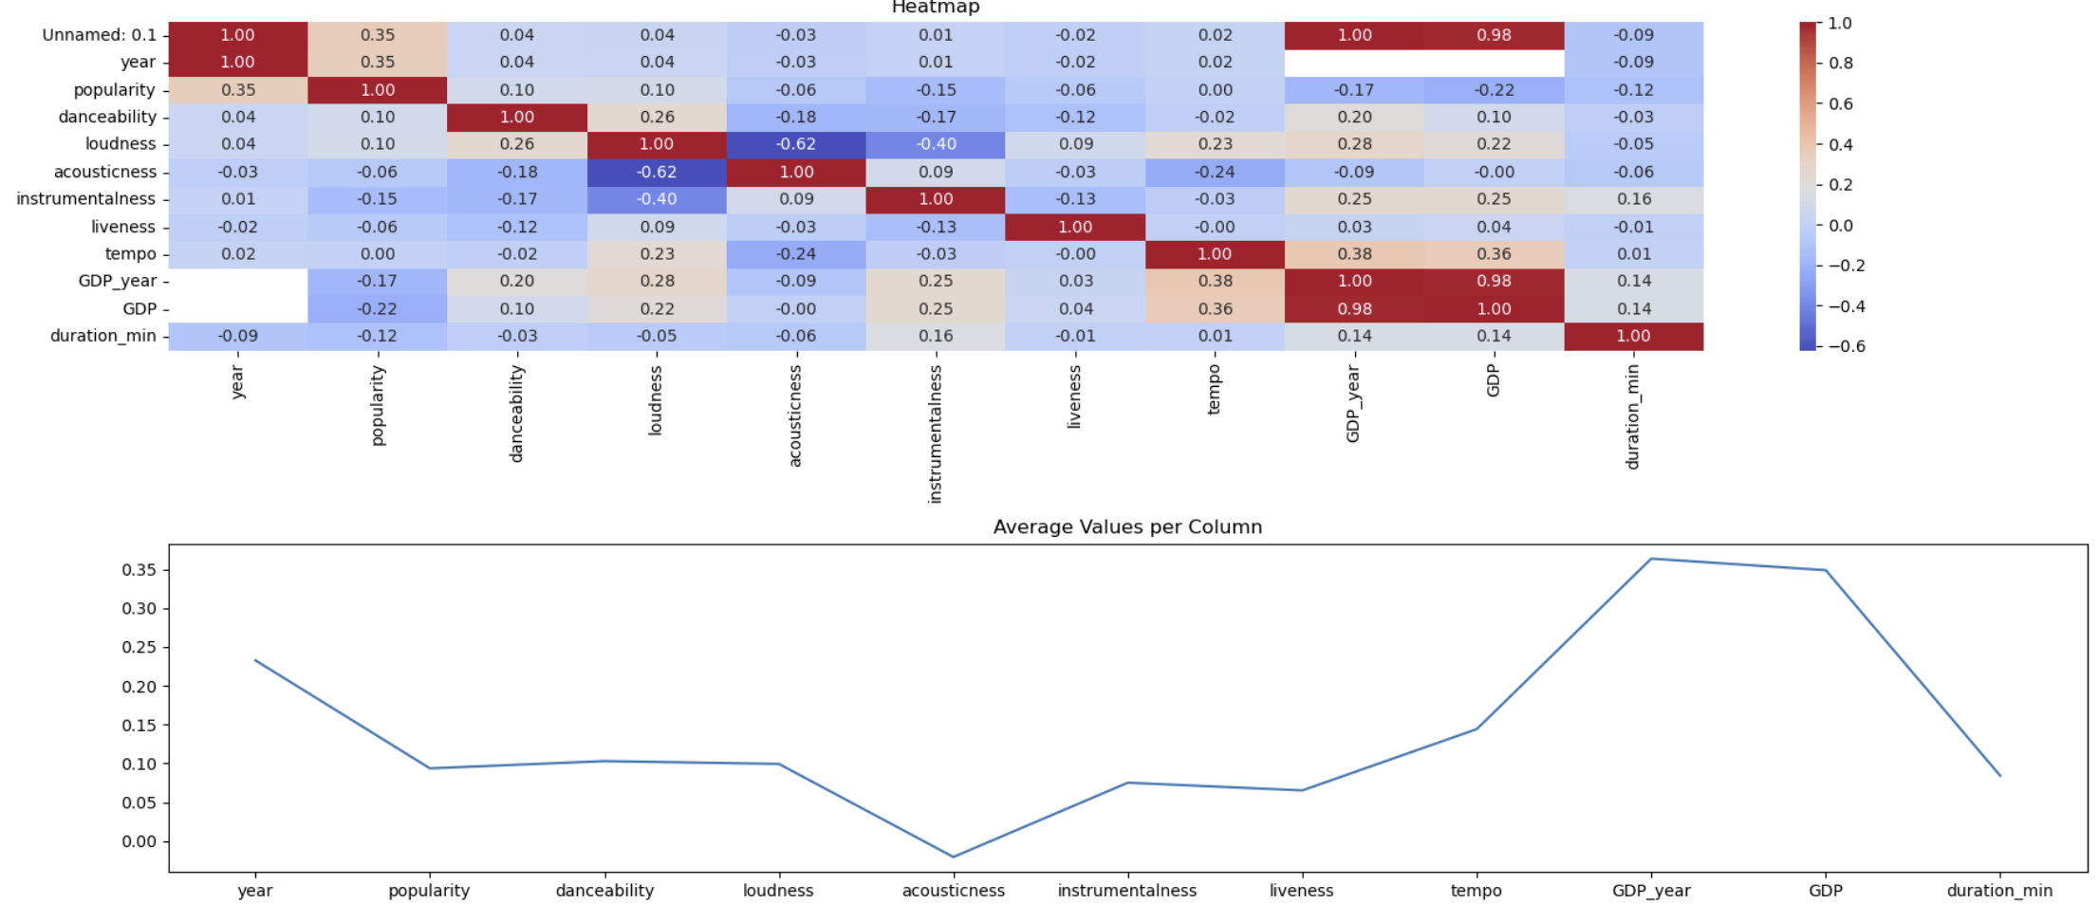
Heatmap findings
Popularity is:
not correlated to tempo
weakly correlated to danceability and loudness.
negatively corelated to acousticness, liveness, instrumentalness, duration_min, GDP_year, GDP
strongly correlated to year

Slide 12

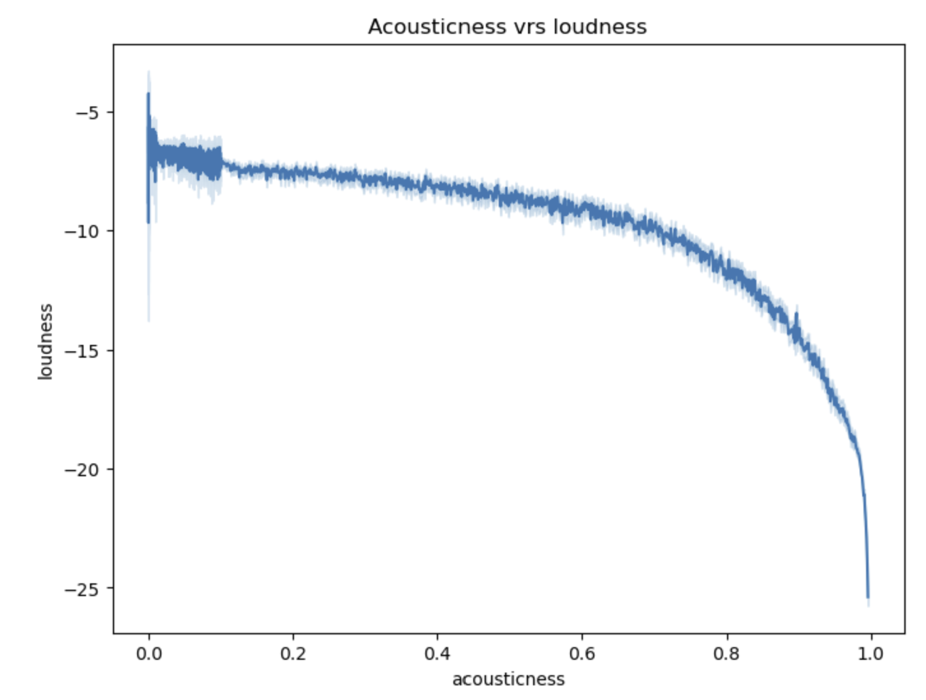
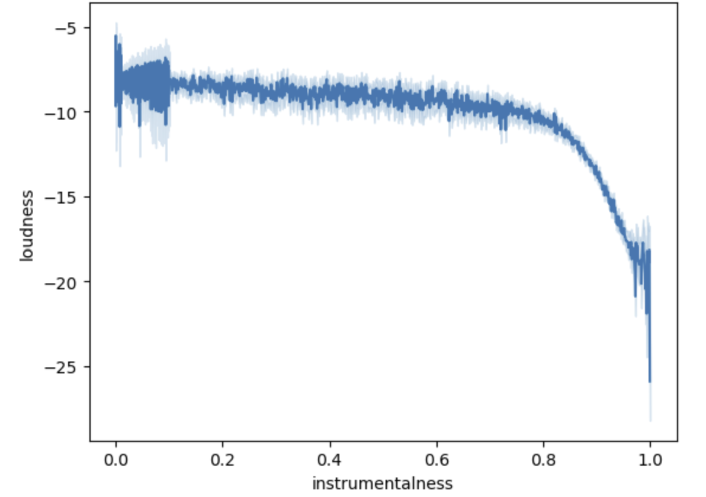
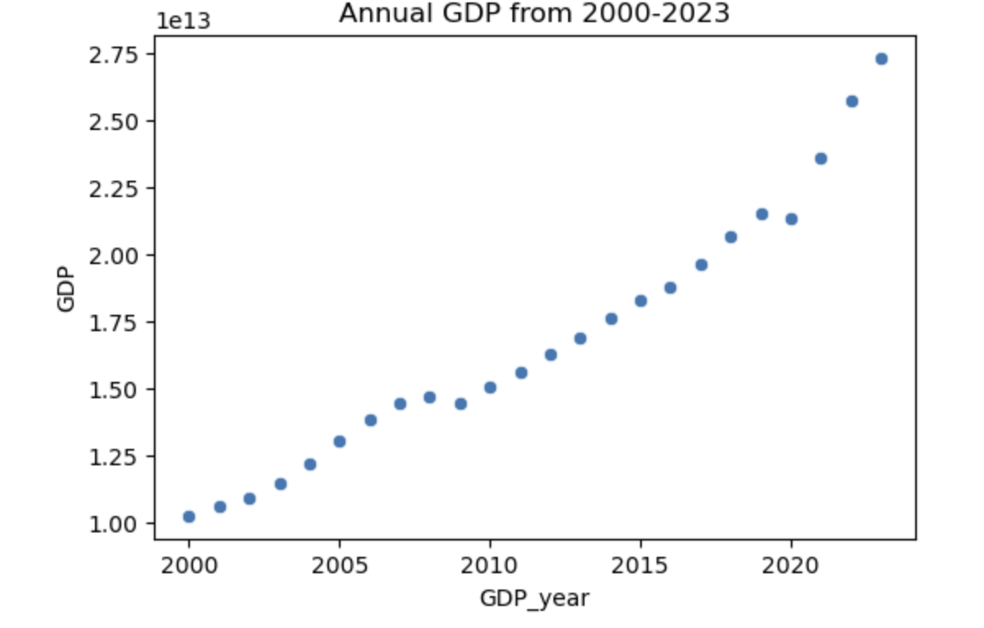
MULTICOLLINEARITY DETECTION
Acousticness vrs Loudness
Instrumentalness vrs Loudness
GDP year vrs GDP

Slide 13

Models
Ridge Regression
ElasticNet
DecisionTreeRegressor
RandonForestClassifier (Non-linear model)

Slide 14

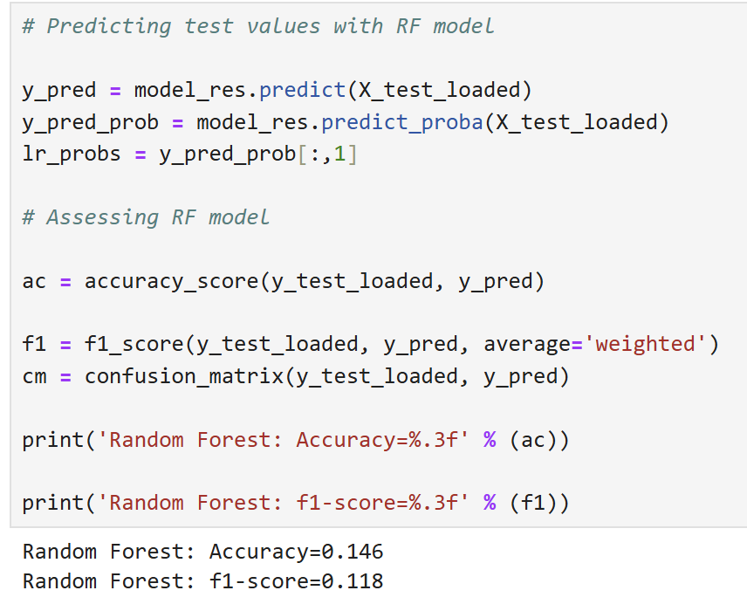
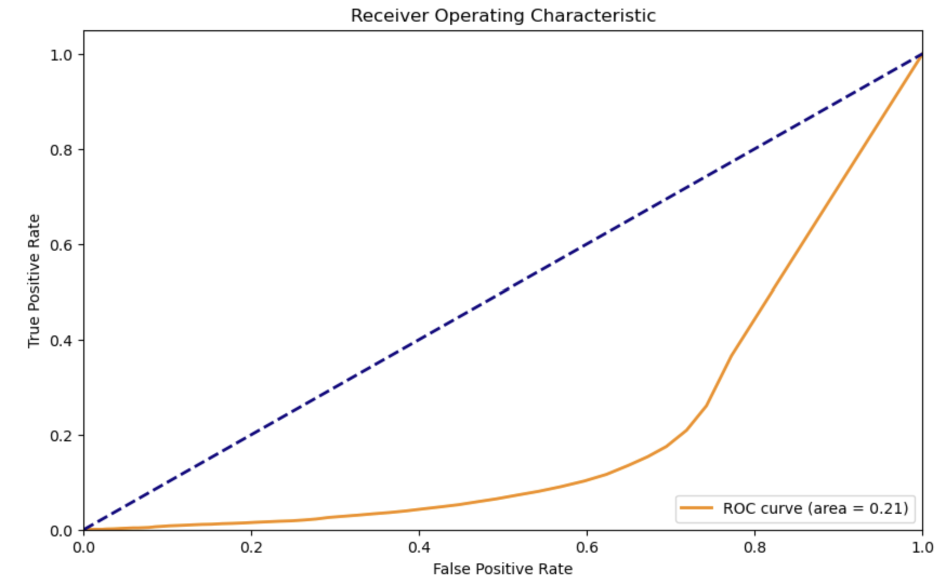
Random Forest model performance
The accuracy and f1 score of the RF model was very low.
The inverted ROC curve revealed how poorly the RF model was performing.
It showed Area Under the Curve to be 0.21

Slide 15

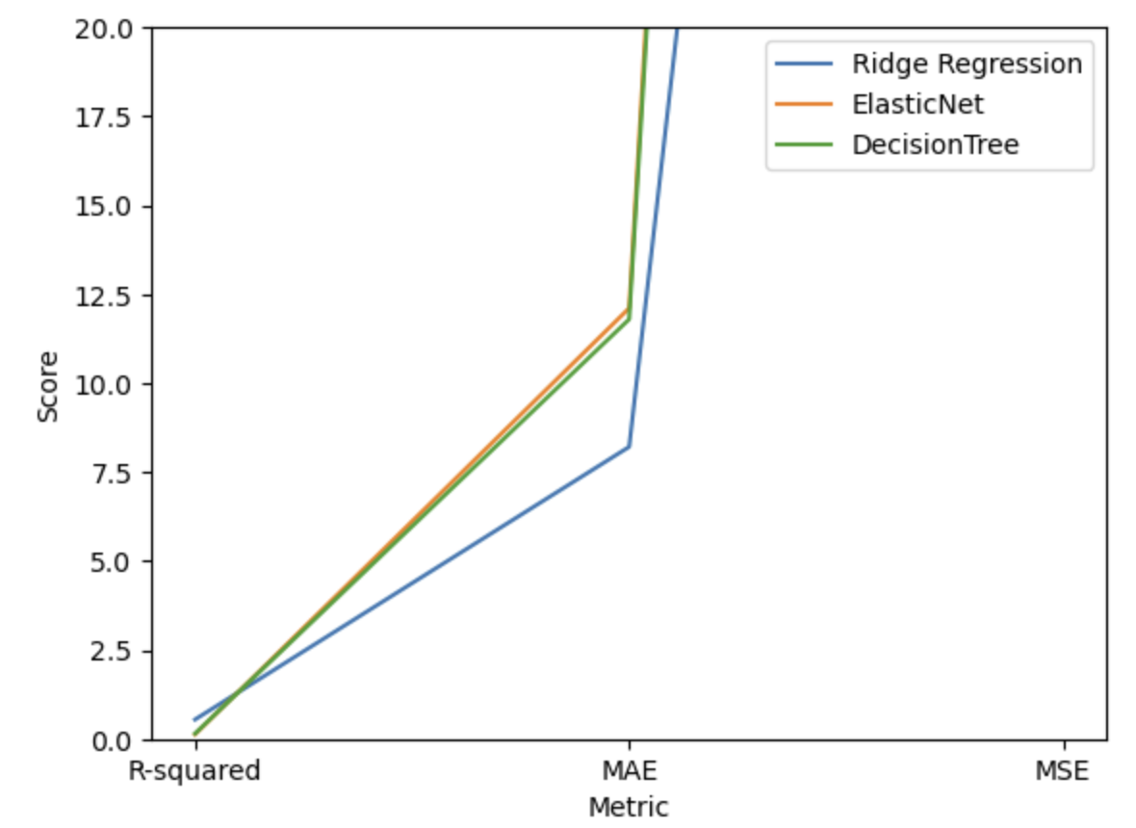
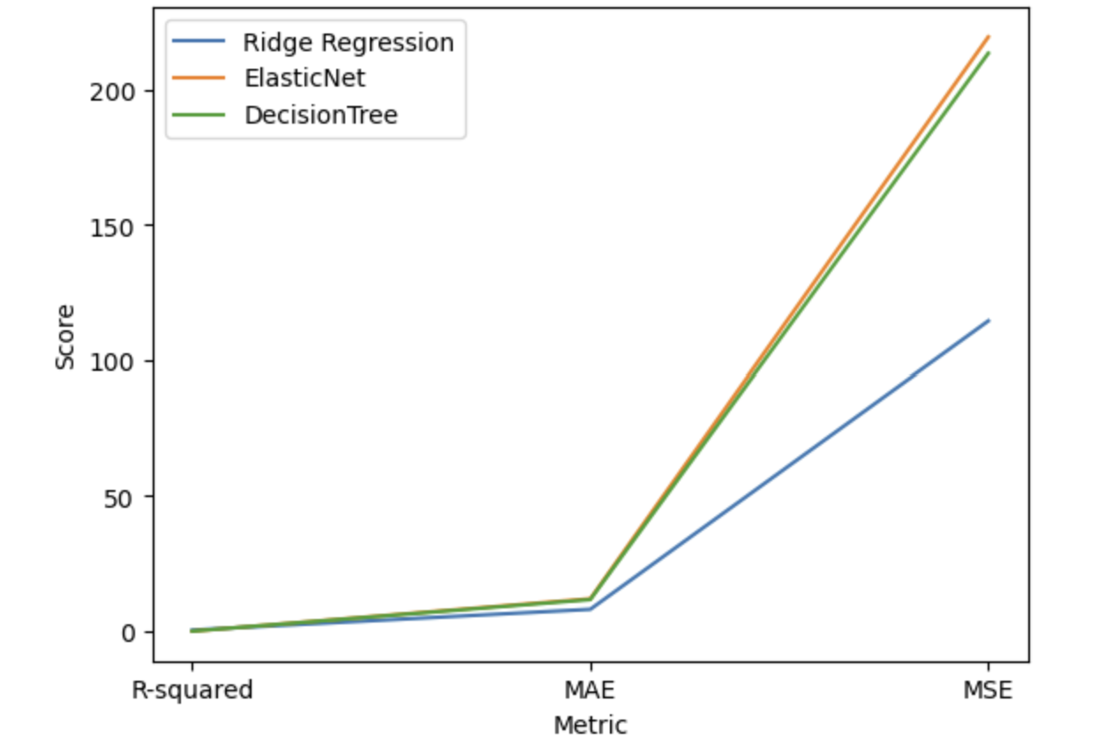
Assessment of Models
The best model is the Ridge Model.
It has the highest r-square value for its predictions
The mean squared error(MSE) and mean absolute error (MSE) values are the lowest of all three linear models built

Slide 16
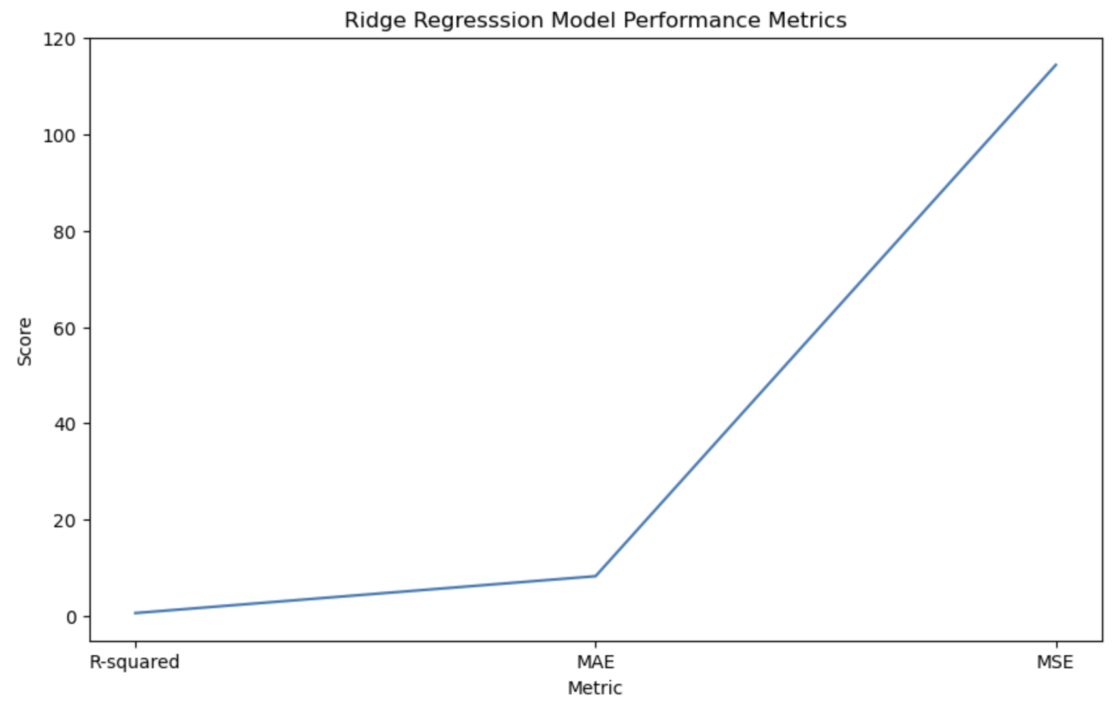
Ridge Model improvement
From the current performance of the Ridge Model, there is more room for improvement because the r squared is low(0.54).
Increased number of features in the data could improve model performance significantly.

Slide 17
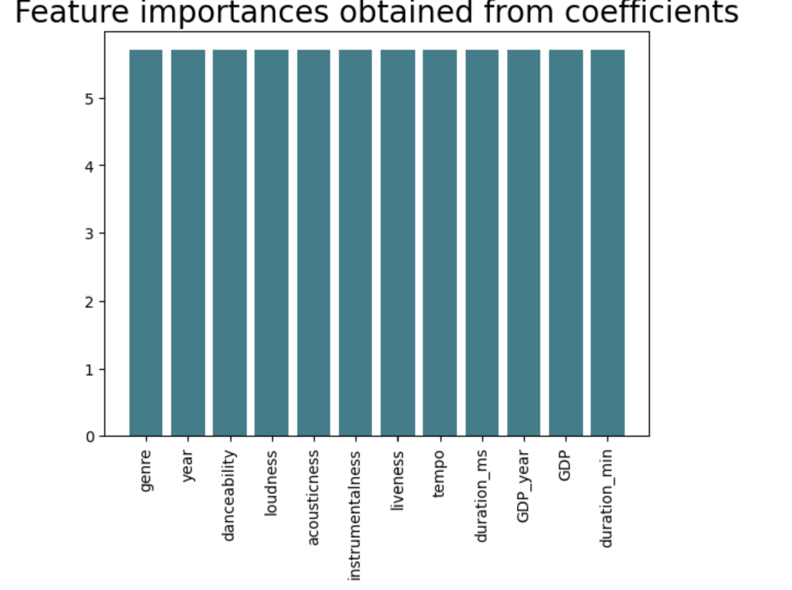
Important features of the ridge model
Genre
Year
Danceability
Loudness
Acousticness
Instrumentalness
Liveness
Tempo
GDP year
GDP
Duration

Slide 18

Potential benefits of acquiring more data
Acquiring more data will improve the robustness of model
Enhance generalizations
Better feature engineering and offer deeper insights

Slide 19

conclusion
The Ridge Regression model will be able to predict the popularity of unreleased songs on Spotify, based on the genre, year, danceability, loudness, acousticness, instrumentalness, liveness, tempo, duration of song in minutes and the GDP of the year of intended song release on the Spotify platform.

